Slide 1

Diving into a Prickly Situation: PISCO

Slide 2
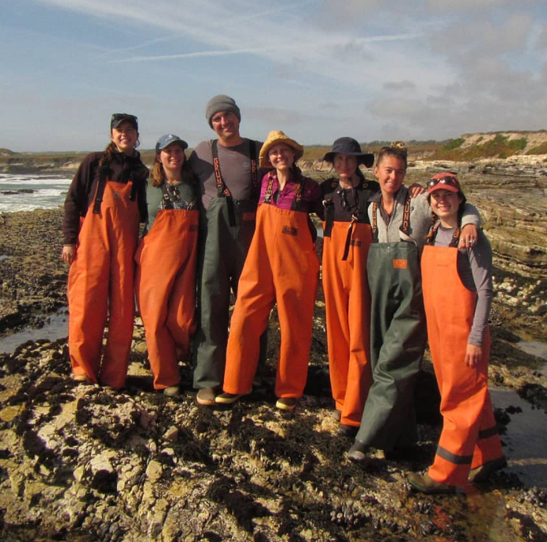
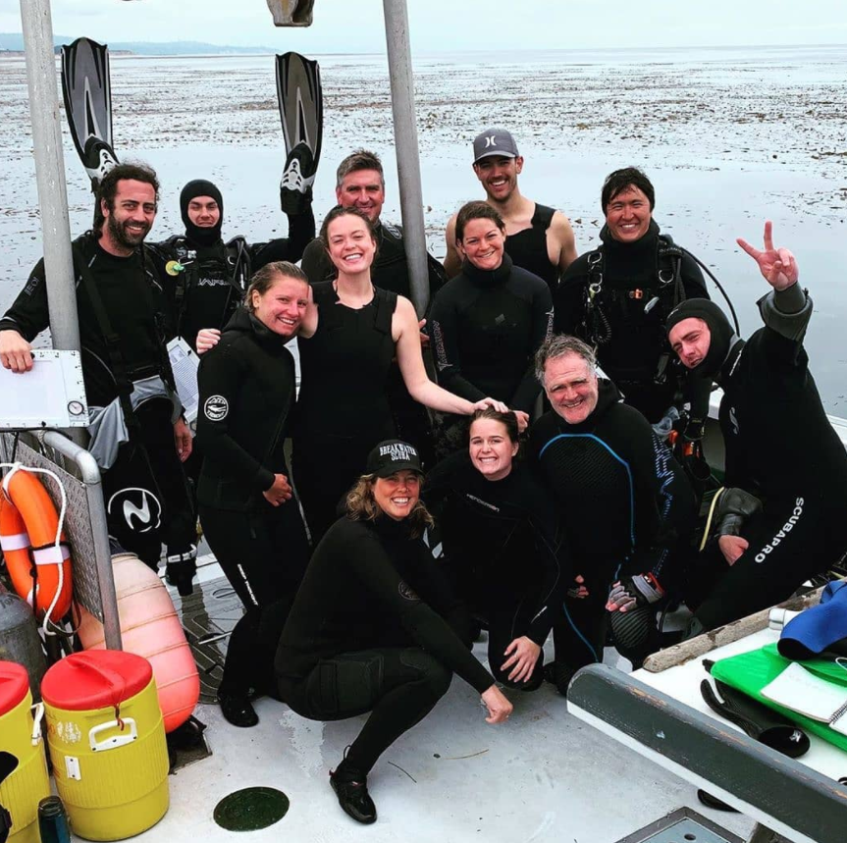
What do they do?

Slide 3
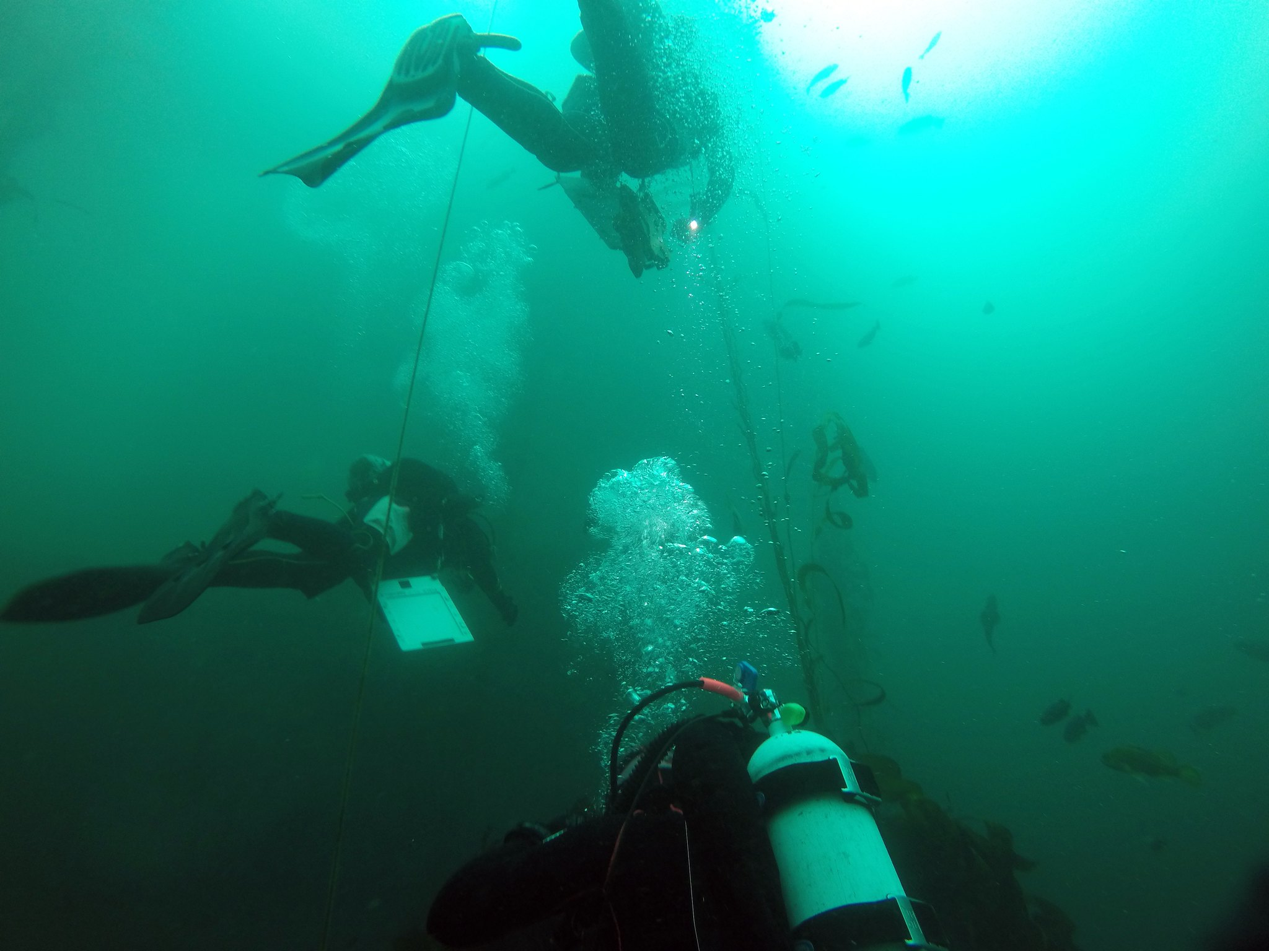
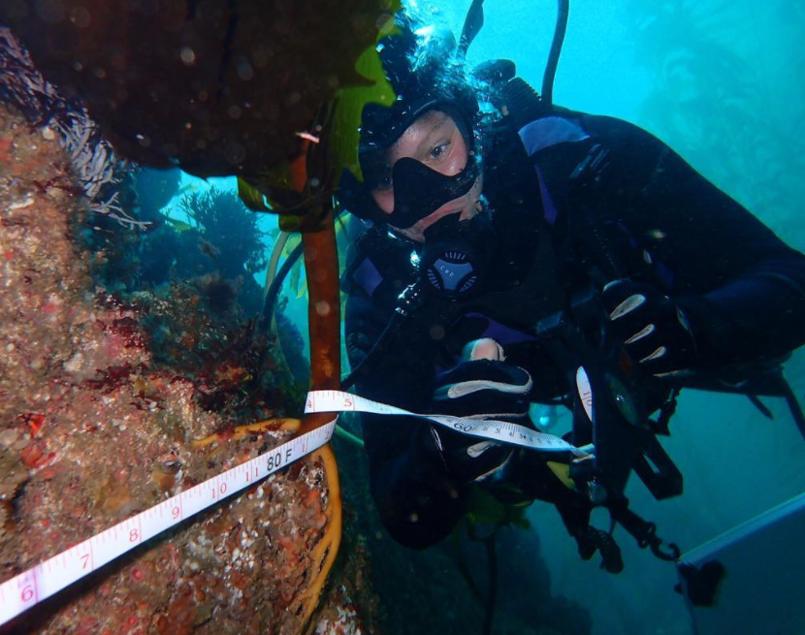
Data Focus

Slide 4
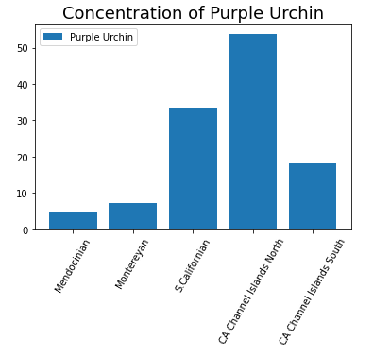
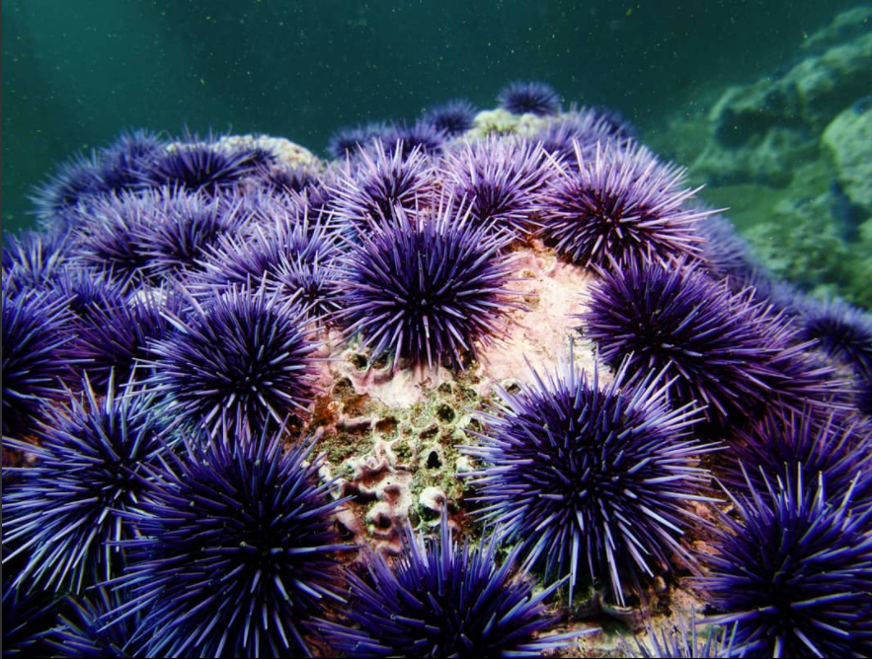
Target Feature:
Strongylocentrotus purpuratus
(Purple Urchin)

Slide 5
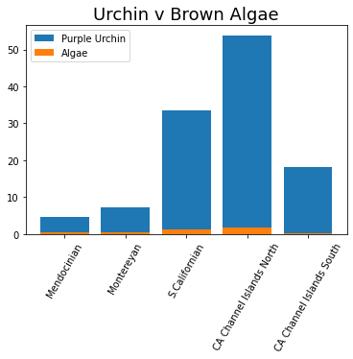

Some Comparisons

Slide 6
How can AI help us predict population trends?
Can make sense of all the data
Find correlations between features
Help promote forward thinking and create strategies to assist preserving biodiversity

Slide 7
Overall Outcome:
Making the target feature a classifier: Present vs Non-present
Xgboost Classifier is the best model
Provided a 85% accuracy
Continuing with biodiversity survey on SCUBA to monitor animals/algae populations

Slide 8
Conclusion/Recommendations:
Predictive Models for Science require LOTS of data
Add features to the data set (Chemical levels, temperature, swell, etc.)
Supporting ‘Urchin Culling’ Events
Supporting the urchins predators:
Seastars
Otters
CA Sheep Head

Slide 9
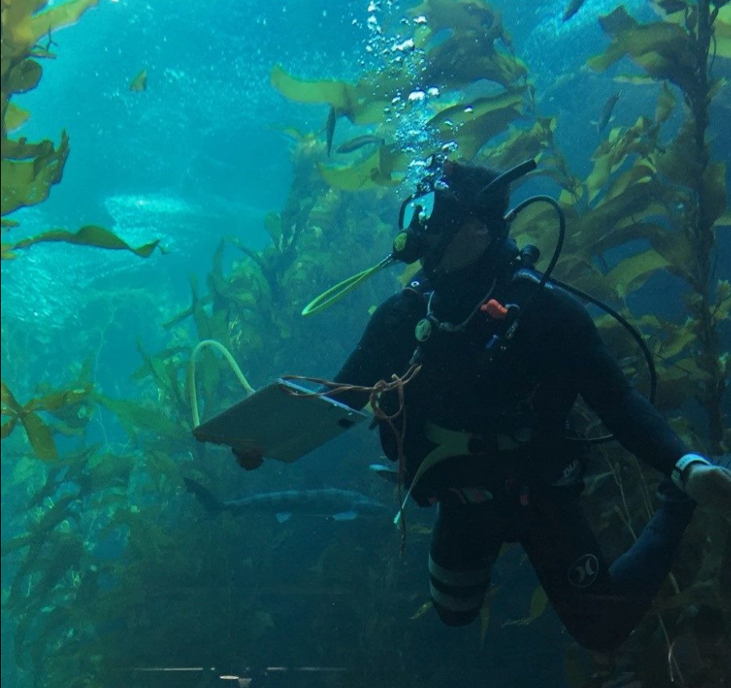
Questions?

